Slide 1
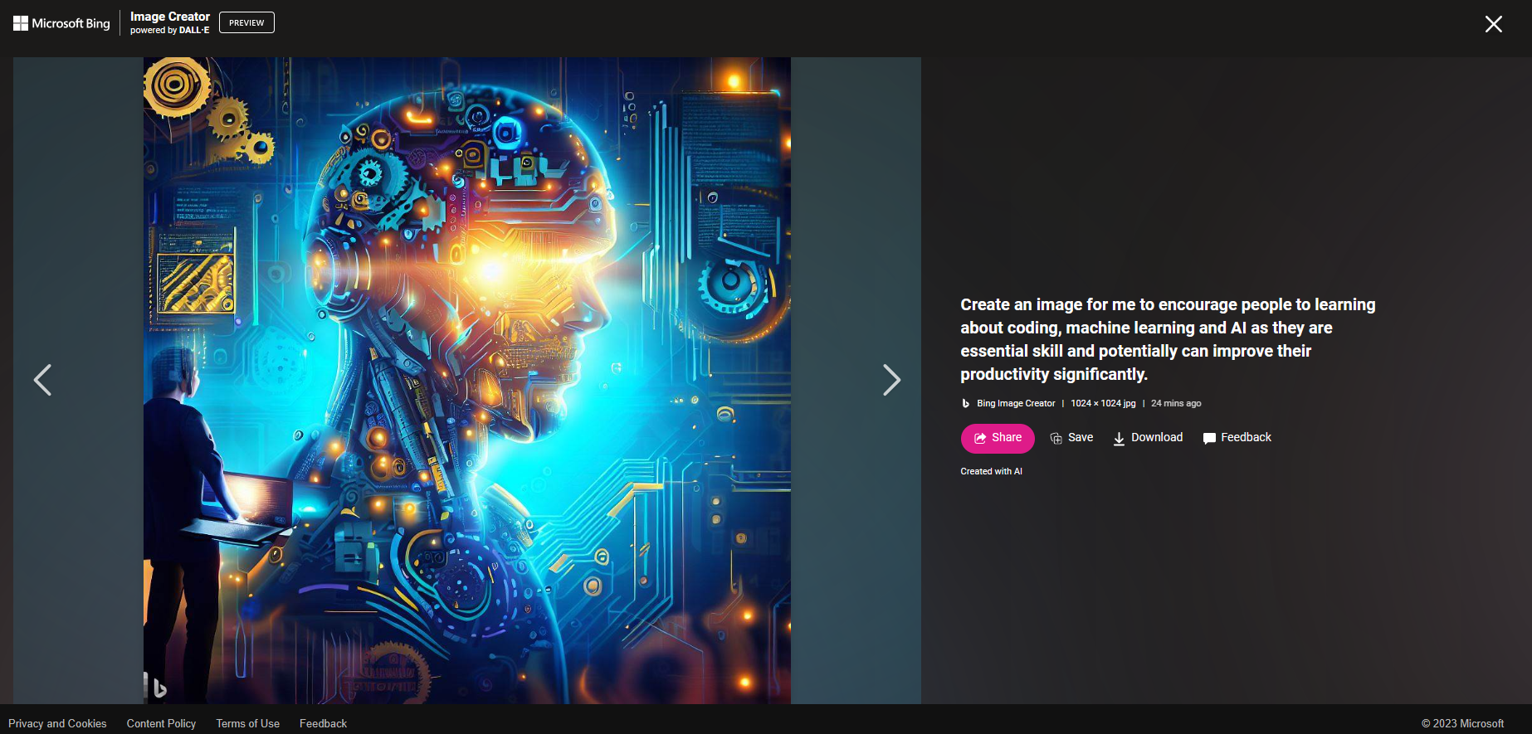
Topic 1: Data Analysis by Jupyter Notebook – Using K-mean Clustering to Analyse the Logging Data (By Wanjing Cai – 40 mins)
Topic 2: Elevate Your Skills: Simplifying AI and Coding for Impactful Advancements in Our Work (By Son Pham – 20 mins)

Slide 2
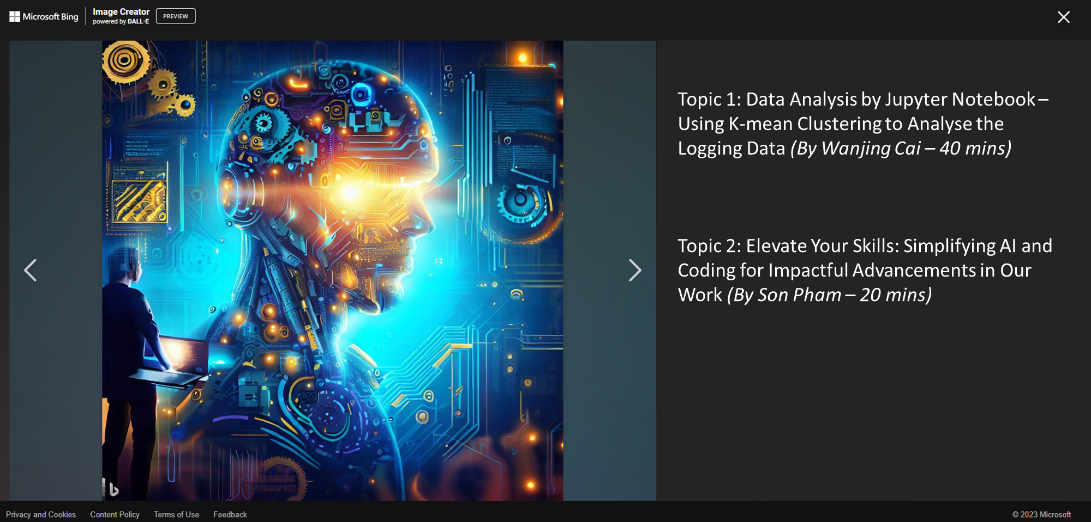

Slide 3
In the last 20mins, Son shares his hobby and opinion of coding and machine learning and recent advancement of Large Language Models (LLM) such as ChatGPT, and the potential to employ into our work.
We hope to have small community on learning, sharing and employing those digital technology in our daily life and work.
Fun story about the prediction/awareness/opinion of the recent AI:
Yann Lecun (Chief AI Scientist at Meta, ACM Turing Award Laureate) in an interview in Jan 2022: “I don't think we can train a machine to be intelligent purely from text. So for example I take an object, I put it on the table and I push the table. It's completely obvious to you that the object will be pushed with the table, right? Because it's sitting on it. There's no text in the world, I believe, that explains this. And so if you train a machine as powerful as it could be, you know your GPT 5000 or whatever it is, it's never going to learn about this. That information is just not present in any text
An ACM Turing Award Laureate is a recipient of the ACM A.M. Turing Award, which is an annual prize given by the Association for Computing Machinery (ACM) for contributions of lasting and major technical importance to computer sciencehttps://en.wikipedia.org/wiki/Turing_Award. It is generally recognized as the highest distinction in computer science and is colloquially known as the "Nobel Prize of Computing"

Slide 4
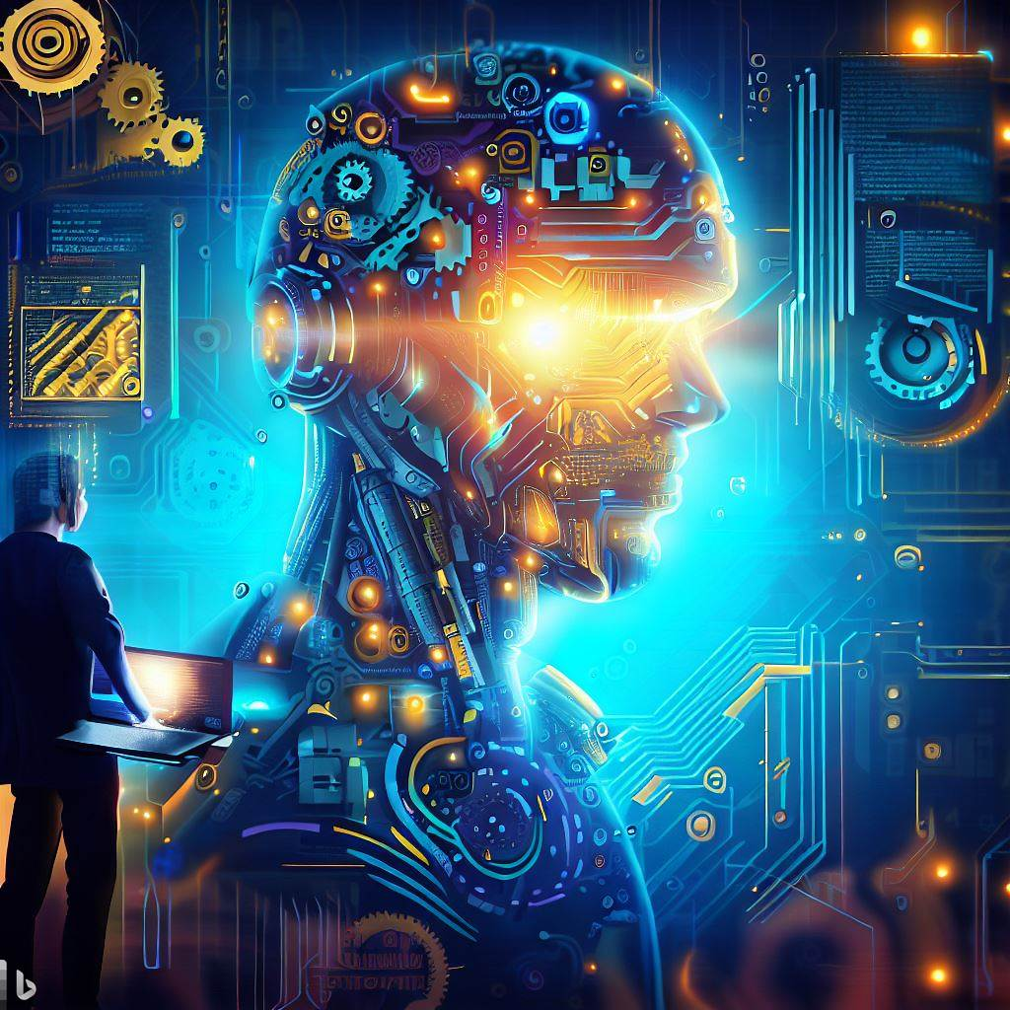

Slide 5
